Slide 1

HAMBURG MIXED RELAY
WORLD CHAMPIONSHIPS
Mixed Relay Historical Analysis · July 2026
USA Triathlon High Performance

Slide 2
Event History — World Mixed Relay Championships
Recent editions at Hamburg; individual-leg splits available 2020–2025
Year
Date
Event
Teams
2020
06 Sep 2020
2020 Hamburg ITU Triathlon Mixed Relay World Championships
16
2021
18 Sep 2021
HAMBURG WASSER 2021 World Triathlon Championship Series Hamburg
15
2022
09 Jul 2022
2022 World Triathlon Championship Series Hamburg
16
2023
15 Jul 2023
2023 World Triathlon Sprint and Relay Championships Hamburg
20
2024
14 Jul 2024
2024 World Triathlon Mixed Relay Championships Hamburg
16
2025
12 Jul 2025
2025 World Triathlon Mixed Relay Championships Hamburg
17
Note: 2013–2019 editions are in the events table; individual-leg timing data not available for those years.

Slide 3
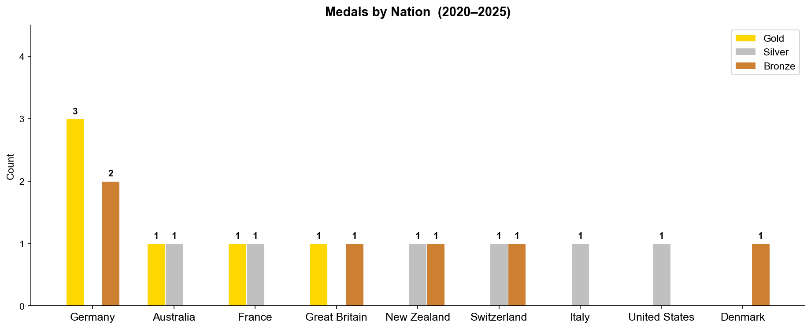
Nation Podium Record — Mixed Relay World Championships
Gold / silver / bronze finishes by nation, 2020–2025

Slide 4
Year-by-Year Results — Final Standings
Top-4 finish order and winning team time for each edition
Year
1st
2nd
3rd
4th
Win Time
2020
France
United States
Great Britain
Norway
1:18:26
2021
Germany
Italy
Denmark
New Zealand
1:21:40
2022
Great Britain
Australia
Germany
Switzerland
1:20:52
2023
Germany
New Zealand
Switzerland
United States
1:22:09
2024
Germany
Switzerland
New Zealand
Great Britain
1:19:54
2025
Australia
France
Germany
Great Britain
1:16:53

Slide 5
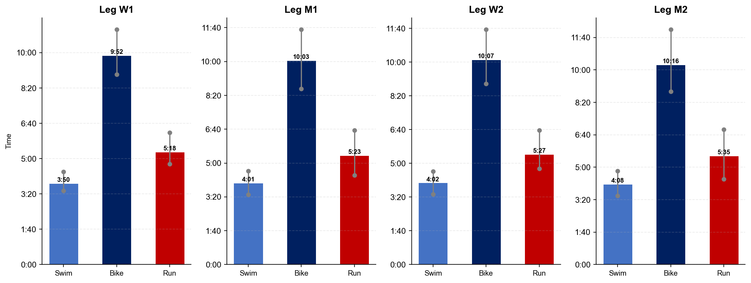
Leg Split Profiles — Average Time by Segment
Mean swim / bike / run per relay leg; whiskers show field min–max range

Slide 6
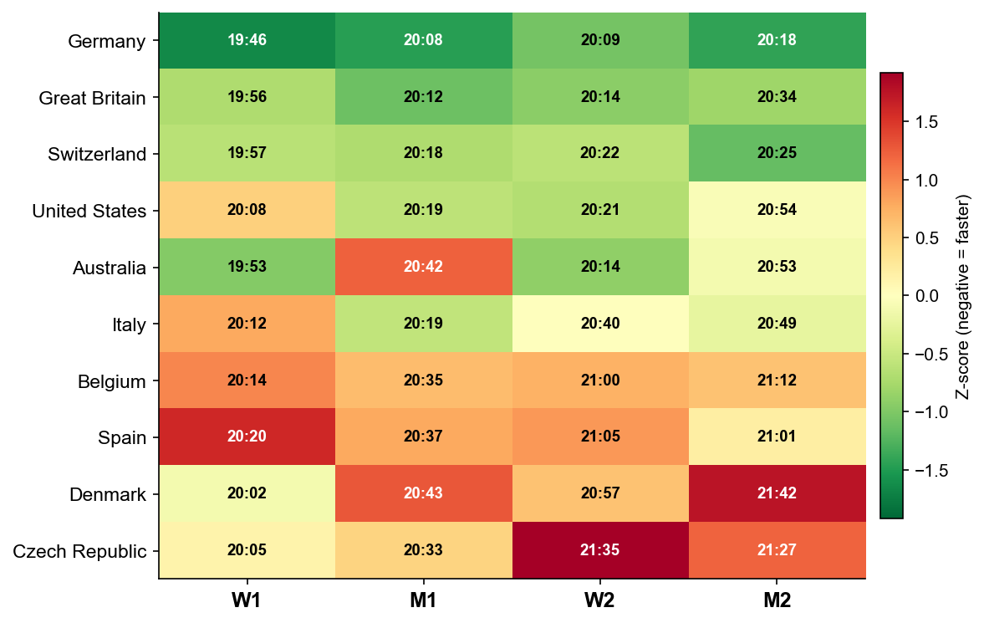
Country Leg Strengths — Relative Performance by Leg
Z-score of mean leg time per slot. Green = faster than field average, red = slower.

Slide 7
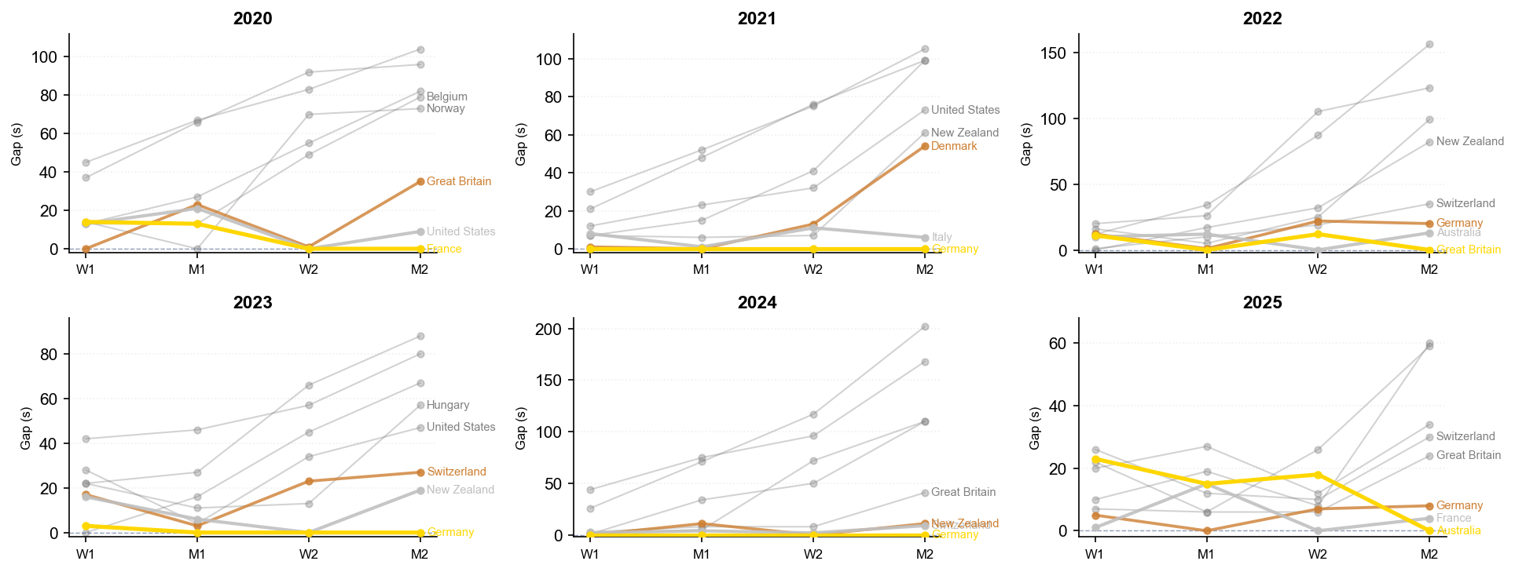
Race Dynamics — Gap to Leader at Each Handoff
Cumulative gap in seconds at end of each leg. 0 = leading team. Top 8 teams shown per year.

Slide 8
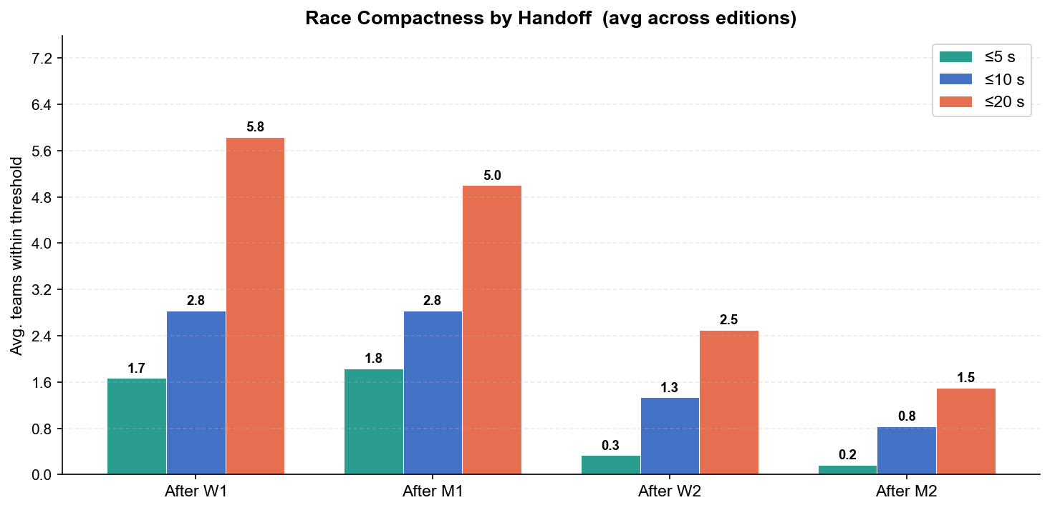
Competitive Density — Teams Within Threshold at Each Handoff
Average number of teams (excl. leader) within 5 / 10 / 20 seconds of the leader, averaged across all editions

Slide 9
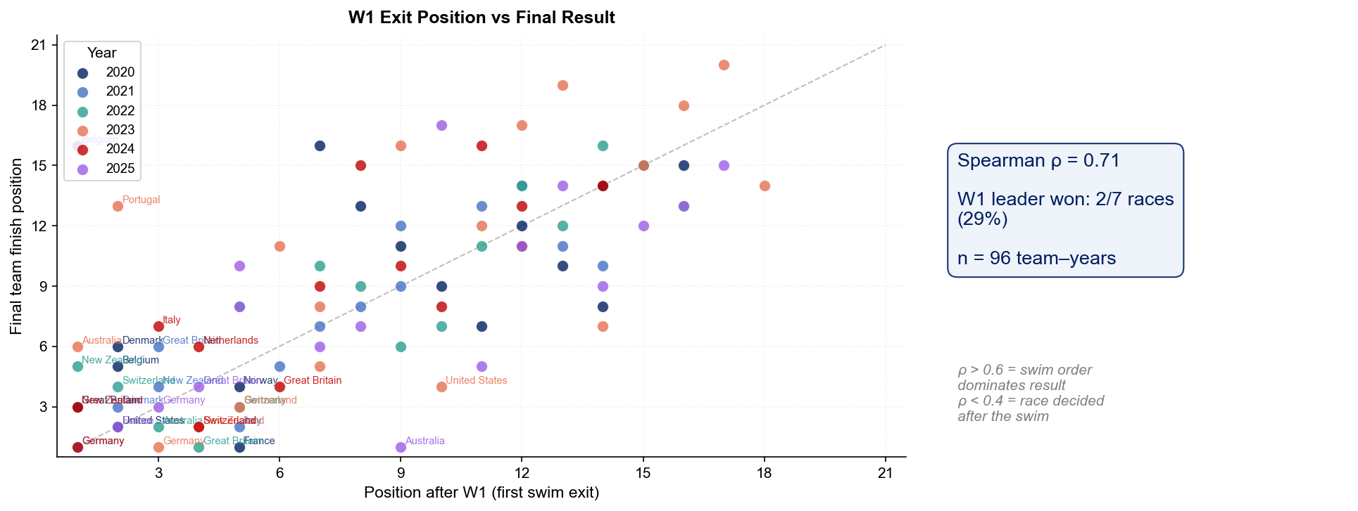
Predictive Power of Leg 1 — Does W1 Decide the Race?
W1 (first swimmer) exit rank vs final team finish. Points on the diagonal = perfect prediction.

Slide 10
Key Takeaways — Hamburg Mixed Relay
2020–2025 analysis summary
Most decorated nation: Germany (3 gold medals)
Fastest W1 swim: Sweden (avg 3:33)
Fastest M1 bike: Individual Neutral Athlete (avg 9:25)
Winning time trend: 93s faster from 2020 to 2025
Race format: W–M–W–M leg order, 750m swim / 20km bike / 5km run per leg
Split data coverage: 2020–2025 (6 editions with full individual-leg timing)

